Slide 1
1) A synapomorphy
A) Is shared by all members of a clade of interest and also by their more distant ancestors as well as other groups
B) Is a trait that is similar in unrelated groups of organisms because of similar past selection
C) Is a trait shared by a clade of interest that is a derived feature of that group
D) Is the morphology of the synapse

Slide 2
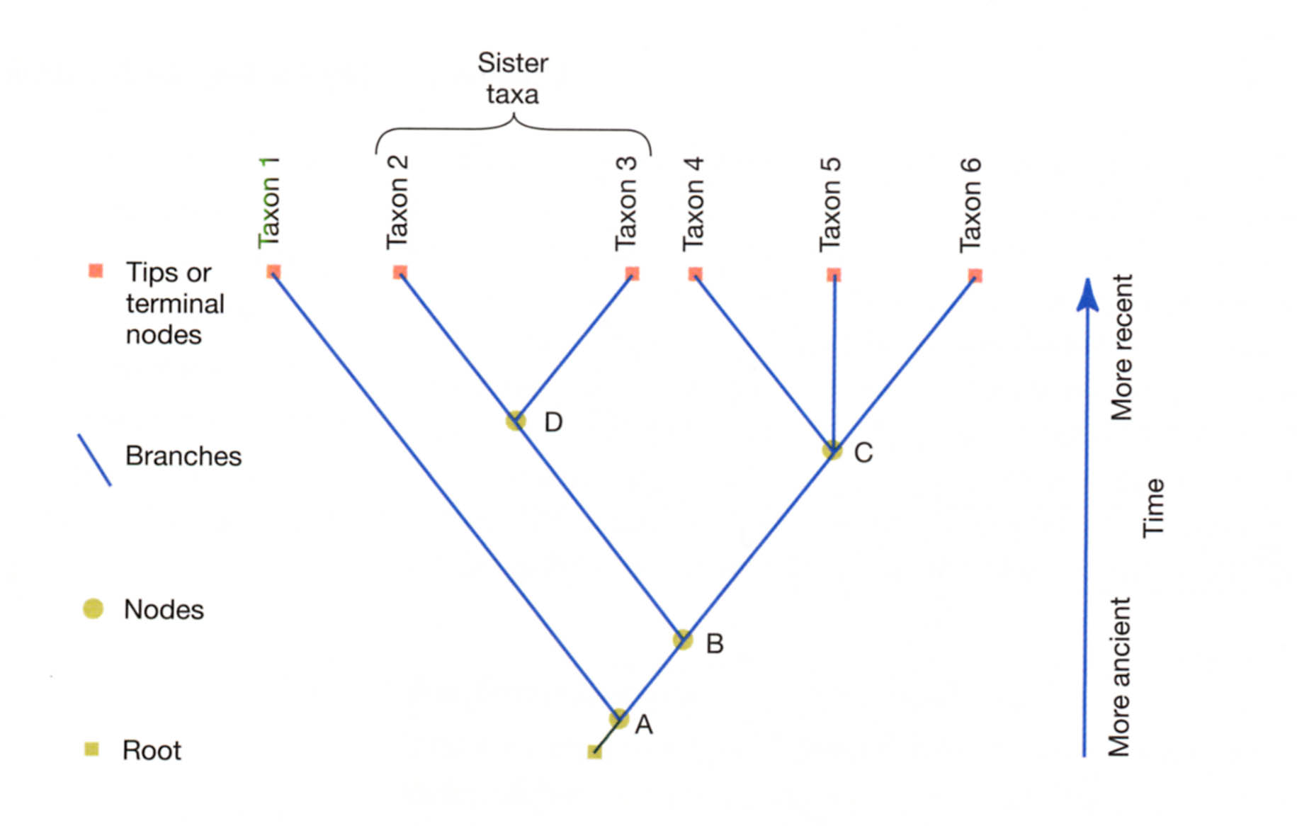
2) Which node is a polytomy? = C

Slide 3
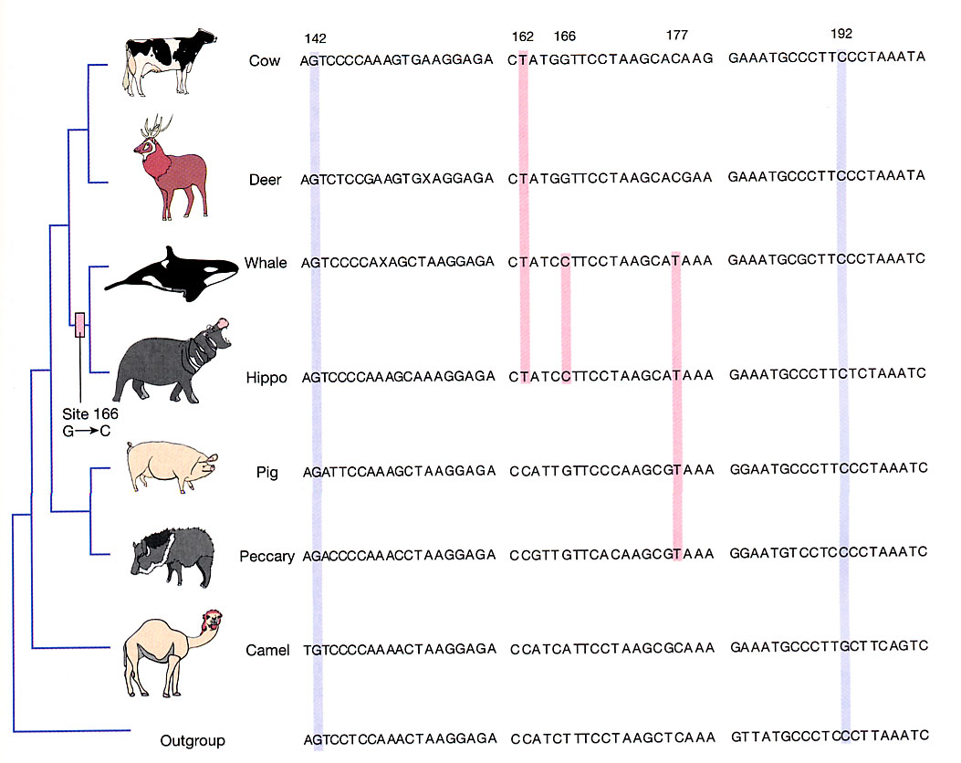
3) Which nucleotide residue is a synapomorphy of whales and hippos?
142
162
166
177
192

Slide 4
4) A really well supported phylogeny would
A) show concordance among multiple data sets
B) depend upon the analytical technique used
C) only use a cladistic approach
D) confirm the relationships that you think should be correct before you got data
E) always include humans as an outgroup

Slide 5
Questions 5), 6), AND 7)
5) which is paraphyletic = A
6) which is polyphyletic = B
7) which is monophyletic = C
A)
B)
C)

